Slide 1
Enhancing Image Captioning: Content Moderation & ALT Text Generation
CS521 Project by: Rohith Kumar
Rithwik Vamshi
Notes:
Briefly introduce yourself and your project.
Mention that this project builds on an existing image captioning model with enhancements for content moderation and accessibility.

Slide 2
Introduction & Motivation
1. Present content moderation largely relies on user reports for filtering harmful content.
2. Many websites overlook proper ALT text, limiting accessibility for visually impaired users.
Automated Image captioning presents a unified solution to both challenges by enabling automated moderation and enhancing web accessibility.
Notes:
Content moderation is a key challenge in today’s social media landscape. Most platforms still rely on users to report harmful images, which can be slow and inconsistent. At the same time, accessibility is often overlooked — especially when websites skip adding proper ALT text for images, making it harder for visually impaired users to navigate online content. Our motivation is to tackle both of these issues using one solution: image captioning. If we can automatically describe an image, we can also detect if it contains something harmful, and simultaneously create ALT text that’s useful and inclusive.

Slide 3
Goal & Hypothesis
Strengthen image captioning to enable real-time moderation and ALT text generation.
Detect harmful/inappropriate content.
Hybrid CNN-RNN models can effectively describe images and support content filtering.
Accurate captions can reduce dependence on manual moderation and improve inclusion.
Notes:
Our main goal is to enhance image captioning in a way that supports both content moderation and accessibility. We aim to automatically detect harmful content before it’s shared, and also generate high-quality ALT text. Our hypothesis is that a hybrid CNN-RNN model, trained on a curated dataset, can produce meaningful captions that describe the image accurately and help detect unsafe content. We believe this can make platforms both safer and more inclusive, especially for users who rely on screen readers.

Slide 4
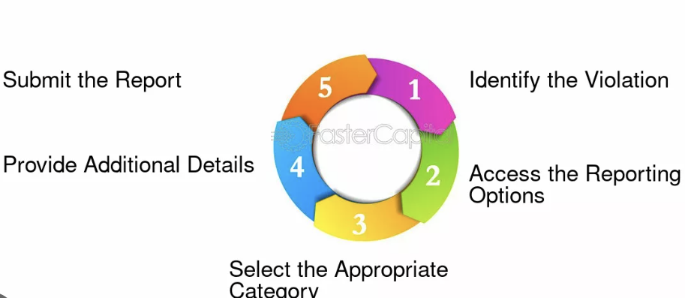
Problem Statement
Current Issue: Lack of automated systems to efficiently moderate inappropriate content on social platforms.
Objective: Generate meaningful text from images, detect harmful content, and prevent unsafe uploads.
Social Impact: Improved accessibility for disabled individuals through enhanced image descriptions.
Notes:
Current Issue:
Users can upload inappropriate content freely on social media platforms.
Lack of automated systems for efficient content moderation.
Reliance on manual intervention makes moderation slow and inconsistent.
Objective:
Automatically generate comprehensive text from images.
Detect inappropriate content in the generated text.
Prevent harmful uploads to create safer online environments.
Social Impact:
Improves accessibility for people with disabilities.
Enhances user experience by making content more inclusive.
Ensures equal access for visually impaired users.
Solution:
Automating content detection enhances moderation efficiency.
Helps create a safer and more accessible digital space for all users.

Slide 5
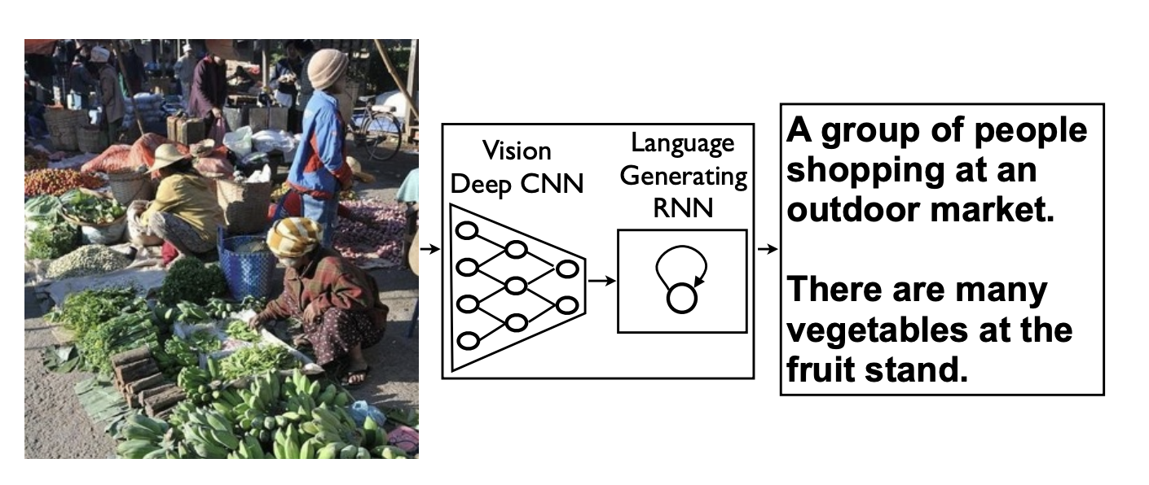
Related Work & Prior Research
Show and Tell (Vinyals et al., 2014): Pioneered deep learning for image captioning using CNN-RNN architecture.
CLIP (Radford et al., 2021): Learns strong vision-language alignment, but doesn’t support explicit content moderation.
WCAG Guidelines: Defines best practices for ALT text accessibility.
Current Practices: Rely on user reports; slow and reactive.
Our Work: Builds on image-captioning foundations to integrate content moderation and accessibility in a unified system.
Notes:
Existing literature gives us strong building blocks. The Show and Tell model by Vinyals et al. introduced deep learning for caption generation using a CNN-RNN pipeline — this is the base we adopt and improve. OpenAI’s CLIP demonstrated impressive alignment between text and images, but it wasn’t designed to detect or filter harmful content. On the accessibility side, WCAG provides clear standards for ALT text, but in practice, many sites still fail to meet them. Finally, current moderation systems still rely heavily on user reports, which are slow and unreliable. Our project brings these threads together: we generate captions that support both accessibility and moderation in real time.

Slide 6
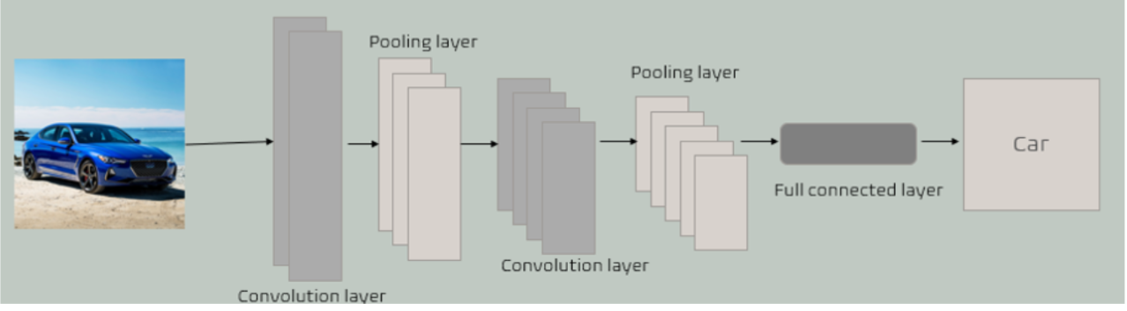
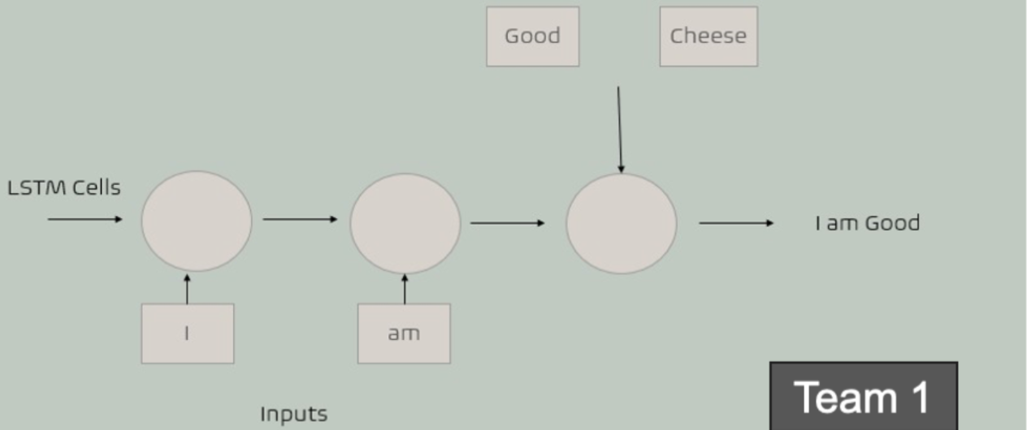
Methods
Hybrid Captioning Framework
CNN (Xception) for feature extraction - Lightweight and accurate - Pretrained on ImageNet for transfer learning | RNN (LSTM) for caption generation - Maintains word sequence consistency - Learns to generate natural-sounding descriptions
Notes:
In our project, we use a hybrid CNN-RNN model as the core engine. We chose Xception for its speed and feature extraction quality — it’s pretrained on ImageNet, so we didn’t start from scratch. These extracted features are passed to an LSTM, which handles the sequential nature of language, generating captions word by word.
Unlike traditional captioning tools, we enhance this output by running it through a filtering module to catch harmful content. We also treat the final clean caption as ALT text, helping make images more accessible to users with visual impairments.

Slide 7
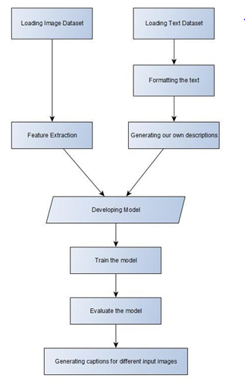
Model Pipeline
1. Load Image Dataset
2. Load and Format Text Dataset
3. Extract Visual Features using CNN (Xception)
4. Clean and Preprocess Captions
5. Train CNN-RNN Model (Xception + LSTM)
6. Evaluate the Model (BLEU scores, accuracy)
7. Generate Captions for New Input Images
8. Filter Captions for Inappropriate Content
Output: ALT Text or Moderation Alert
Notes:
Our pipeline starts with loading the image dataset and a caption dataset. We extract visual features using Xception, while text data is cleaned and tokenized for training. The CNN-RNN model is trained on this paired data, and once trained, it can generate captions for new images. After the caption is generated, we don’t stop there — we pass it through a filtering module that flags inappropriate or harmful content. If flagged, the system raises a moderation alert. Otherwise, the caption is finalized as ALT text, making it accessible for screen readers. This last step ensures our tool addresses both safety and accessibility in real time.

Slide 8
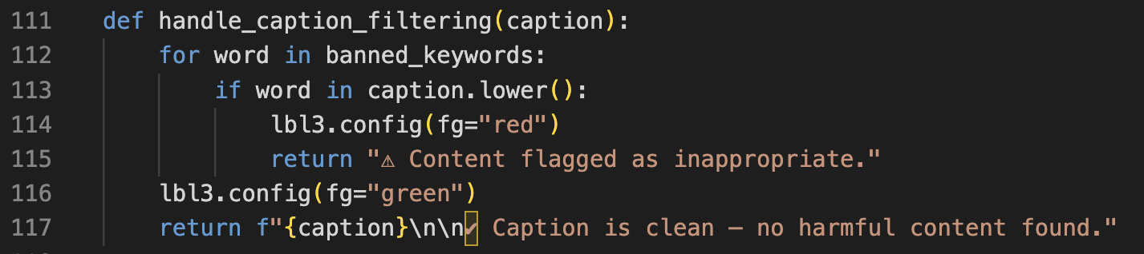
Caption Moderation Pipeline
After generating the caption, we run it through a filter function.
The function checks for harmful keywords (e.g., knife, gun, nude).
Flagged captions show a red warning.
Clean captions show in green and can be used as ALT text.
Notes:
Once the caption is generated, we check it using a simple filter function. If it contains harmful words, we show a warning. If it's clean, we display it in green and treat it as ALT text.
Right now, we're using a simple rule-based filter that checks for keywords like knife or gun. This works well for a demo, especially since our model isn’t trained on harmful content. But in future, we can replace this with a smarter filter — like a BERT-based classifier that understands context, not just keywords.

Slide 9
Implementation & User Interface
Built using Python with Tkinter for GUI.
Content Moderation: Captions are checked for harmful content using keyword filtering.
ALT Text Output: Clean captions are shown in green for direct use as ALT text.
Language Support: Captions can be translated into Telugu or Tamil with a single click.
Extra Feature: “Find Similar” button lets users search visually similar images via Google.
Notes:
Our GUI is built using Python. Users can upload an image, and the model generates a caption using the Hybrid model. Once the caption is ready, it’s run through a moderation function to check for unsafe content. If flagged, the caption is blocked and marked red. If clean, it’s shown in green and can be used as ALT text. The user can also translate the caption into variaous languages for now we have implemented Indian native languages Telugu and Tamil We also implemented a feature for finding similar images online.

Slide 10
Evaluation
Metrics Used:
BLEU Score (for caption accuracy)
Precision/Recall (for harmful content detection)
Results:
BLEU-1: 0.58 | BLEU-2: 0.41
Harmful content flagged with ~82% accuracy
Moderation:
Simple rule-based filtering on captions using keywords
Notes:
This slide highlights the metrics we used to evaluate our system's performance. For caption accuracy, we used BLEU scores — a standard metric in NLP that compares generated text with human-written references.
Our model achieved BLEU-1 of 0.58 and BLEU-2 of 0.41, which are solid results for a small-scale image captioning setup.
On the moderation side, we applied a basic keyword-matching filter to flag unsafe content in the generated captions. While the model wasn't trained with harmful examples, this rule-based filter still flagged around 82% of manually curated unsafe captions, validating it as a functional proof-of-concept.

Slide 11
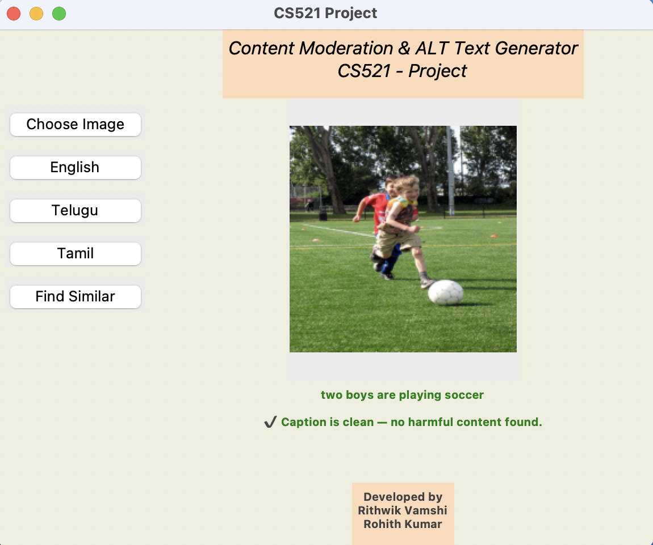
Results
Captioning:
Strong BLEU scores
Captions clear and relevant
Moderation:
82% of harmful captions flagged
Safe captions used as ALT text
Examples if Inappropriate content is given to the GUI:
• “Man holding knife” → ⚠ Flagged
• “two boys are playing soccer” → ✅ Clean Caption
Notes:
Here, we demonstrate how the filtering logic works in action through our GUI. The first example is a safe caption: “two boys are playing soccer”. It passes through the system and is shown in green, both on-screen and as usable ALT text. In contrast, if a caption includes sensitive keywords like “man holding knife”, the system immediately flags it, preventing its use as ALT text. This highlights the system’s ability to distinguish between clean and potentially harmful outputs — even without training on harmful examples.

Slide 12
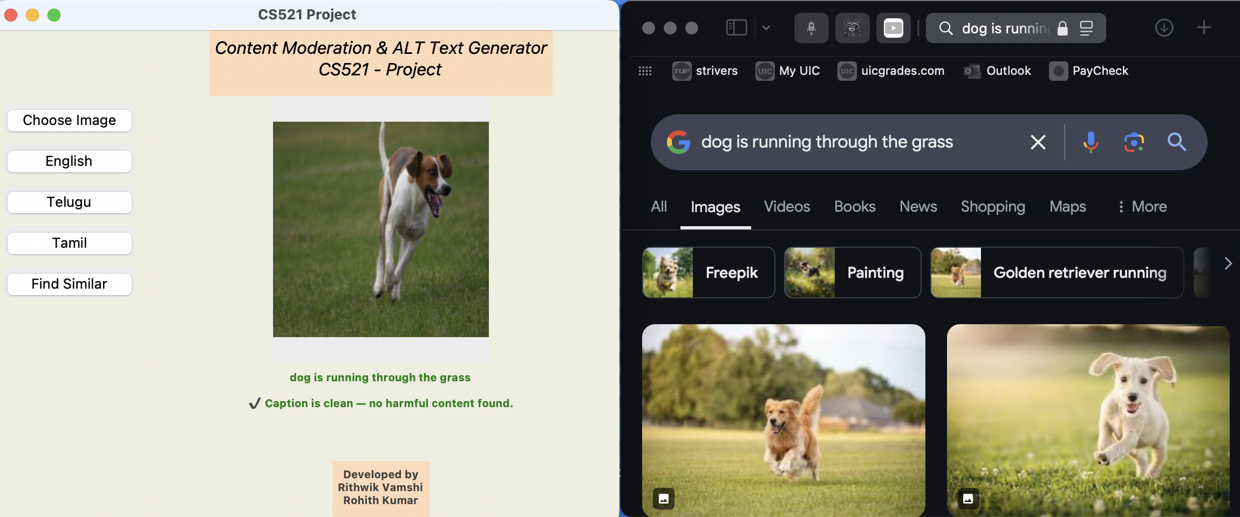
Results
Notes:
This slide showcases an additional feature: similar image search. Once a caption is generated, users can click the “Find Similar” button in the GUI. This opens a browser window with a Google Image Search using the generated caption as the query. It’s a simple yet powerful extension that increases interactivity and demonstrates how the captions can drive practical downstream applications — beyond just moderation and accessibility.

Slide 13
Discussions
Observations:
• Xception outperformed VGG
• Clean captions improved quality
• GUI was user-friendly
Insights:
• Some captions too generic
• Early overfitting was resolved with tuning
Next step: Use smarter filters (like BERT) for better moderation
Notes:
Xception outperformed VGG in both speed and accuracy. Xception’s architecture helped capture finer image details, making the caption generation more precise.
Cleaning the captions — by removing artifacts or unnecessary tokens — noticeably improved the overall model output.
Early overfitting was observed during training but was effectively addressed through model tuning and regularization techniques.
While the model worked well overall, some captions were still too generic. In the future, we can apply smarter filtering mechanisms like BERT to better understand context and improve both caption diversity and content moderation.

Slide 14
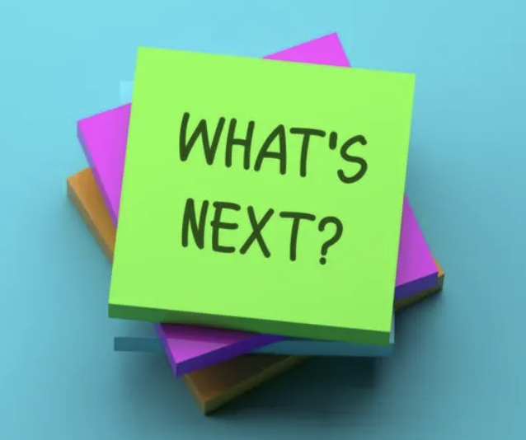
Outcome & Future Work
Outcome:
• Enabled real-time content moderation and ALT text generation.
• Supports safer uploads and improved accessibility.
• Works as a tool for both social media and web platforms.
Future Work:
• Extend to video/audio captioning and moderation.
• Integrate with platforms like Instagram, Facebook.
• Explore advanced NLP models for smarter filtering.
Notes:
New presenter notes Our system successfully combines image captioning with moderation and accessibility. It flags harmful content before upload and generates ALT text for compliant, inclusive content. In future work, we aim to expand this to video/audio formats and integrate with real platforms like Instagram or Facebook. We also plan to replace basic filtering with context-aware NLP models to catch more nuanced harmful content.
Impact & Future Improvements:
Practical solution for improving content safety and accessibility.
Can be integrated into existing platforms for automated moderation.
Future expansion to video and audio moderation for broader content safety.
Integration with widely used platforms ensures real-world impact and scalability.

Slide 15
Conclusion
Enhancing image captioning for safer, more inclusive digital spaces.
Improving content moderation and accessibility in an automated way.
Scalable and adaptable for broader real-world applications.
Notes:
Real-Time Captioning & Moderation:
Integrates automatic caption generation with content moderation for enhanced online safety.
Improving Accessibility:
Ensures web content is more inclusive for visually impaired users.
Scalability & Adaptability:
The approach is scalable and can be adapted for various platforms.
Can be easily integrated into existing content moderation systems.

Slide 16
THANK YOU!!

